Slide 1

Computer Engineering Department A.P. Shah Institute of Technology G.B.Road,Kasarvadavli, Thane(W), Mumbai-400615 UNIVERSITY OF MUMBAI Academic Year 2020-2021

Slide 2
Synopsis on Image Captioning Submitted in partial fulfillment of the degree of Bachelor of Engineering(Sem-7) in Computer Engineering By Shyamkrishna Menon – 18102014
Siddharth Nair – 18102044
Atharva Ranade - 18102016
Omkar Thavai – 18102061
Under the Guidance of Prof. S.S. Mujawar

Slide 3
1.Project Conception and Initiation

Slide 4
1.1 Abstract
This project aims at generating automated captions by learning the contents of the image. At present images are annotated with human intervention and it becomes nearly impossible task for huge commercial databases. The image database is given as input to a deep neural network (Convolutional Neural Network (CNN)) encoder for generating “thought vector” which extracts the features and nuances out of our image and RNN (Recurrent Neural Network) decoder is used to translate the features and objects given by our image to obtain sequential, meaningful description of the image. In this project, we systematically analyze different deep neural network-based image caption generation approaches and pretrained models to conclude on the most efficient model with fine-tuning.

Slide 5
1.2 Objectives
The goal of this image captioning project is to automatically generate descriptions for a given image, i.e., to capture the relationship between the objects present in the image, generate natural language expressions and predict a caption , and deploy it on web using Flask API.

Slide 6
1.3 Literature Review
Deep Learning based Automatic Image Caption Generation
The aim of the paper is to generate captions to the image which is normally, manually annotated by data annotators. It first creates feature vectors with the help of CNN and later uses RNN for creation of sentences with the help of features gained before.
Show and Tell: A Neural Image Caption Generator
This paper proposes a network of the same name. In this network, deep convolutional network is used for image classification and sentence generation is done by a powerful Recurrent Neural Network which is trained with the visual input so that RNN can keep track of the objects explained by the text.

Slide 7
1.4 Problem Definition
The problem introduces a captioning task, which requires a computer vision system to both localize and describe salient regions in images in natural language. The image captioning task generalizes object detection when the descriptions consist of a single word. Given a set of images and prior knowledge about the content find the correct semantic label for the entire images. First, it is necessary to detect objects on the scene and determine the relationships between them and then, express the image content correctly with properly formed sentences. The generated description is still much different from the way people describe images because people rely on common sense and experience, point out important details and ignore objects and relationships that they imply .

Slide 8
1.5 Scope
The main implication of image captioning is automating the job of some person who interprets the image (in many different fields). Probably, will be useful in cases/fields where text is most used and with the use of this, you can infer/generate text from images.
Social media platforms like Facebook can infer directly from the image, where you are ( beach, cafe etc), what you wear (colour) and more importantly what you’re doing also (in a way).
It will also be helpful to improve search results of google image search.

Slide 9
1.6 Technology stack
Deep learning
Train the model using Convolutional Neural Networks and Recurrent Neural Networks (deep learning model) to detect features from image and predict the captions respectively.
Google Colab
Programming language - Python
Flask - An API of Python used to build web-applications(front - end)
Pandas - Python library for data manipulation and analysis.
opencv - Python Library to load images
numpy - Python Library For mathematical operations

Slide 10
1.6 Technology stack
Keras Framework(Using Tenserflow Backend)
Used for building our model architecture for Image Captioning and also used for importing VGG-16 for Transfer Learning

Slide 11
1.7 Benefits for environment & Society
Image Captioning can play a big role for society.
Our project can be used for educational purpose for teaching pre-primary children to make them aware with what all entities are present within a picture.
Our image captioning model can be used for enhancement of products like Google Lens. Google Lens is used by users to identify objects and provide relative e-commerce links. With our project imbibed, Lens can also explain the scenario to a confused user.

Slide 12
2. Project Design

Slide 13
2.1 Proposed System
First we will import Flickr 30k dataset and process. Flicker datasets are used for image captioning. 30k stands for 30,000 images of various instances.
We use VGG16 model for image captioning. VGG16 is used for embedding of features within the image like identifying a person, thing, etc and LSTM is used for encapsulating all features and describing it as a sentence.

Slide 14
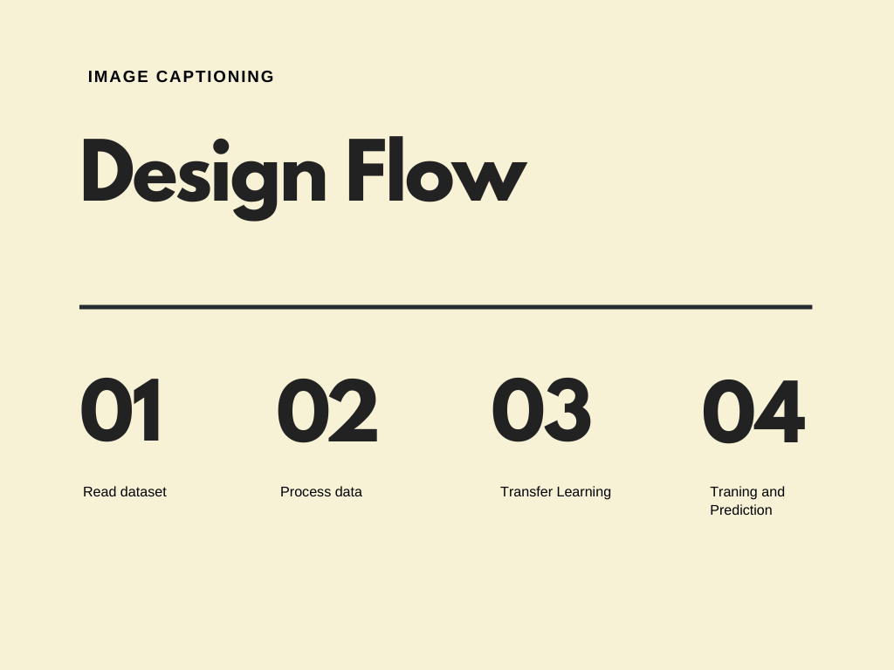
2.2 Design Flow

Slide 15
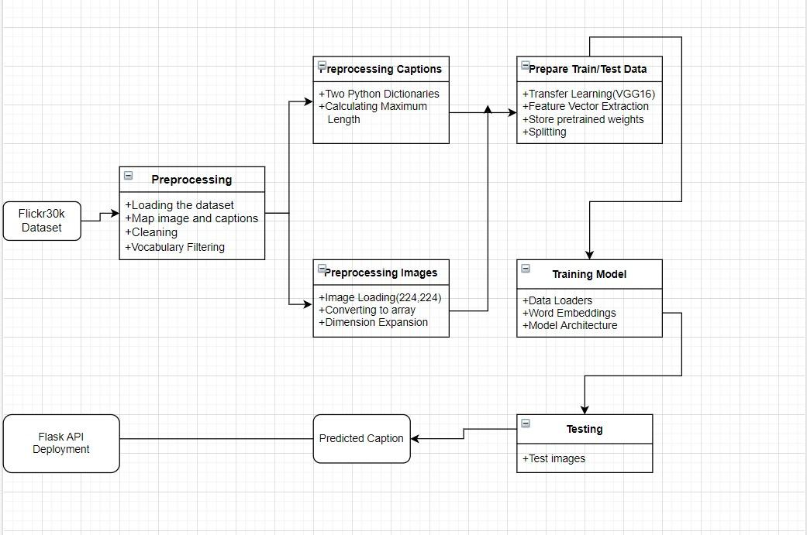
2.3 Class Diagram

Slide 16
2.4 Modules
Read Dataset
Processing of data
Transfer Learning
Training and Prediction

Slide 17
Module 1- Read Dataset
We read the Flickr 30k dataset

Slide 18
Module 2- Processing of data
There are few sub-steps for implementing processing of the dataset
We first input the .csv file. This file will have ImageID of the image and associated captions. An image can have multiple captions.
A description (dictionary) is created where ImageID is considered as key and caption is value.
Since caption can have few unwanted characters eg. #, etc, we remove them. All the cleaned captions are inputted into a text file. We create a vocabulary i.e. count of each word in a caption and count of each word in the whole text document.
A threshold is set so as to keep relevant words only, relevance is found if word count is greater than or equal to threshold.
We create a train and test dataset
Now a start and end sequence has been created.

Slide 19
Module 3- Transfer Learning
We use VGG16 for feature capture. VGG16 is a convolution neural net (CNN) architecture. It is considered to be one of the excellent vision model architecture till date.
VGG16 :
VGG16 is a convolutional neural network model proposed by K. Simonyan and A. Zisserman from the University of Oxford in the paper “Very Deep Convolutional Networks for Large-Scale Image Recognition”. The model achieves 92.7% top-5 test accuracy in ImageNet, which is a dataset of over 14 million images belonging to 1000 classes. It makes the improvement over AlexNet by replacing large kernel-sized filters (11 and 5 in the first and second convolutional layer, respectively) with multiple 3×3 kernel-sized filters one after another.

Slide 20
Module 4- Training and prediction
We first load our data into batches for word embedding process. Word embedding will help us find feature vectors for the words in the training set.
Then a model architecture is been formed. We will use LSTM for sentence formation from the features of caption.
Lastly we predict test sets captions.
Need For LSTM:
In every data point, it’s not just the image which goes as input to the system, but also, a partial caption which helps to predict the next word in the sequence.Since we are processing sequences, we will employ a Recurrent Neural Network to read these partial captions.LSTM is a more powerful RNN architecture, so we use it in this project
So, VGG16 will give us the feature vector, which together with captions will go as input and then our model will predict the caption.

Slide 21
2.5 References
V.Keshavan et al., “Deep Learning based Automatic Image Caption Generation”
O.Vinyals et al., “Show and Tell: A Neural Image Caption Generator”
S.Chengjian et al., “Image Annotation Via Deep Neural Network”
V.Murthy et al ., “Automatic Image Annotation using Deep learning representations”

Slide 22
3.Planning for next semester

Slide 23
Planning
We will incorporate our model into web. In this manner, anyone can upload an image and a suitable caption will be provided to it.
We will find perfect set of parameters during model architecture.

Slide 24
Thank You

